Slide 1


micro:bit entry video tutorial
Lesson 6
micro:bit basic lesson 6 “Listen to music”
YahBoom micro:bit video tutorial

Slide 2
micro:bit entry video tutorial
Content
Part1
Part 2
Part3
Part 4
Part 5
Learning goals
Preparation
Search for blocks
Combine blocks
Have a try
YahBoom micro:bit video tutorial

Slide 3
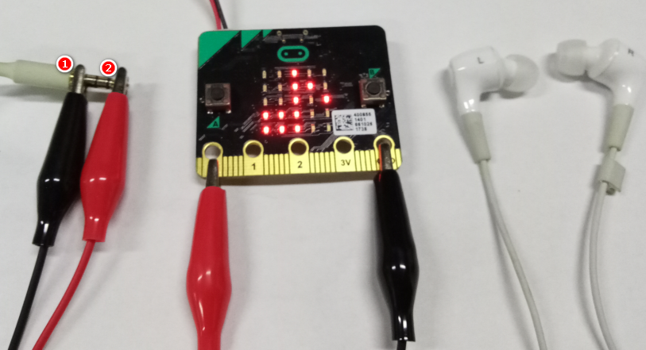
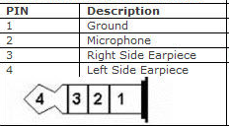
micro:bit entry video tutorial
Part 1
Learning goals
You need two crocodile clips and a pair of headphones for this experiment. First, the black crocodile clip is used to clamp the GND of micro:bit, and the black crocodile clip on the other side clamps the interface of the earphone.
Then use the red crocodile clip to clamp P0, and the other end clamps the interface of the earphone 2.After downloading the program, you can play music from the earphone.
YahBoom micro:bit video tutorial

Slide 4
micro:bit entry video tutorial
Part 2
Hardware:
● 1 X Micro: bit Board
● 1 X Micro USB Cable
● 2 X Crocodile clip cable
● 1 X Headphones
● 2 X AAA batteries
Preparation
Then the micro:bit is connected to the computer through USB, and the computer will pop up a U disk and click the URL in the U disk to enter the programming interface.
YahBoom micro:bit video tutorial

Slide 5
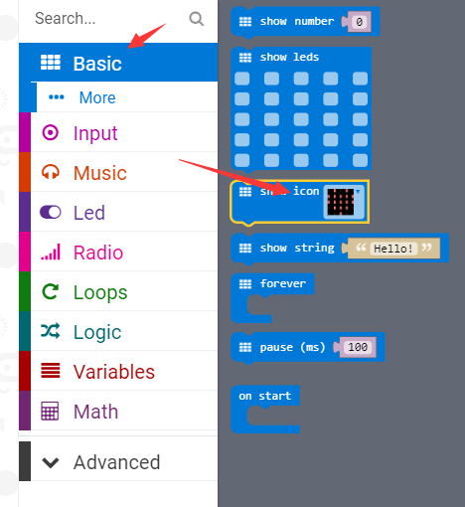
micro:bit entry video tutorial
Part 3
Search for blocks
YahBoom micro:bit video tutorial

Slide 6
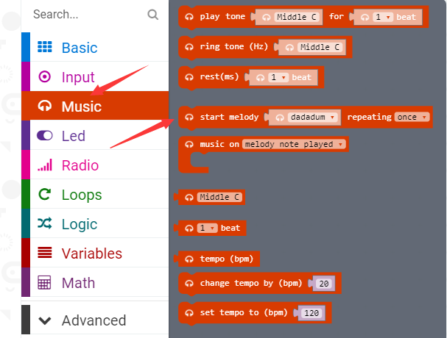
micro:bit entry video tutorial
Part 3
Search for blocks
YahBoom micro:bit video tutorial

Slide 7
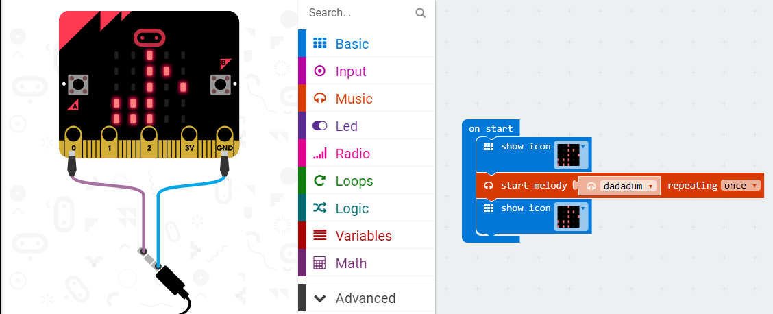
micro:bit entry video tutorial
Part 4
Combine blocks
YahBoom micro:bit video tutorial

Slide 8


micro:bit entry video tutorial
Part 5
Do you learn the course today?
If you learn to do it, give yourself a top quack.
Now give you a homework assignment.
On the basis of the playing music we just realized, plus the function of the key, we play the song after pressing the key, and the name of the song is displayed on the dot matrix.
Start your little brain. Try it.
Have a try
YahBoom micro:bit video tutorial

Slide 9
micro:bit entry video tutorial
micro:bit
project
Thanks for watching！
Powered by YahBoom
YahBoom Micro:bit video tutorial

